Slide 1


STONEWALL TERRACE
DALLAS, TX

Slide 2
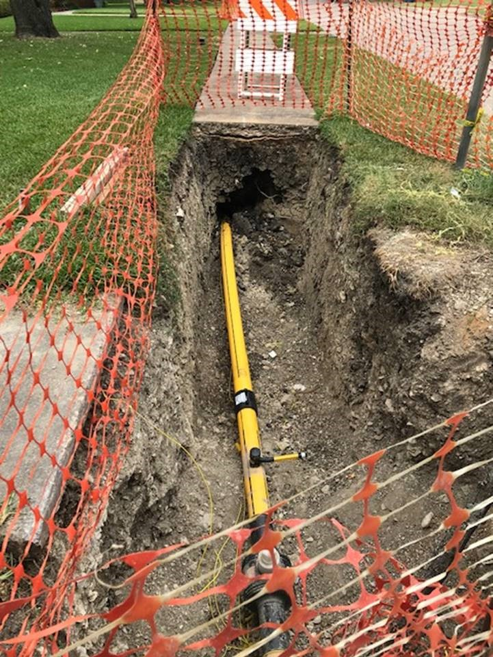
DriscoPlex® 8400 Series 4” IPS DR11 installation by Horizontal Directional
Drilling (HDD) at the intersections of Mockingbird & Skillman and Woodcrest & Skillman.

Slide 3
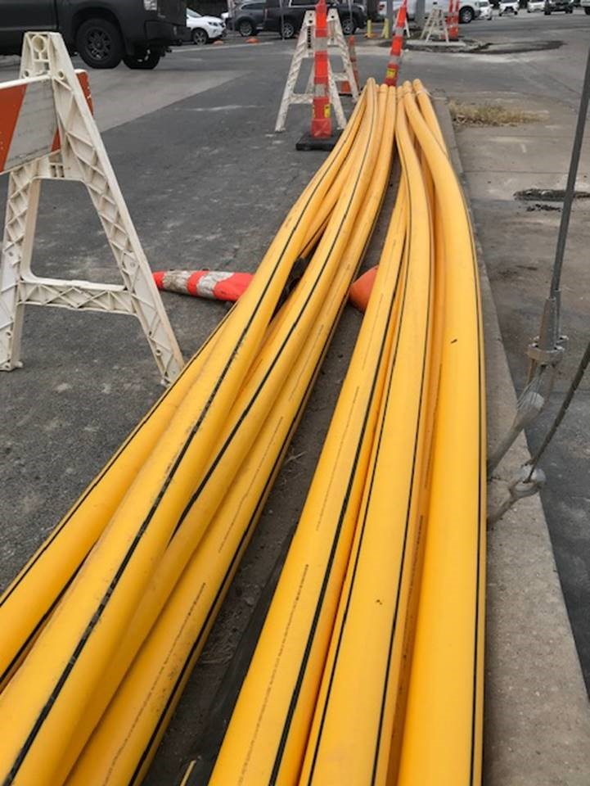
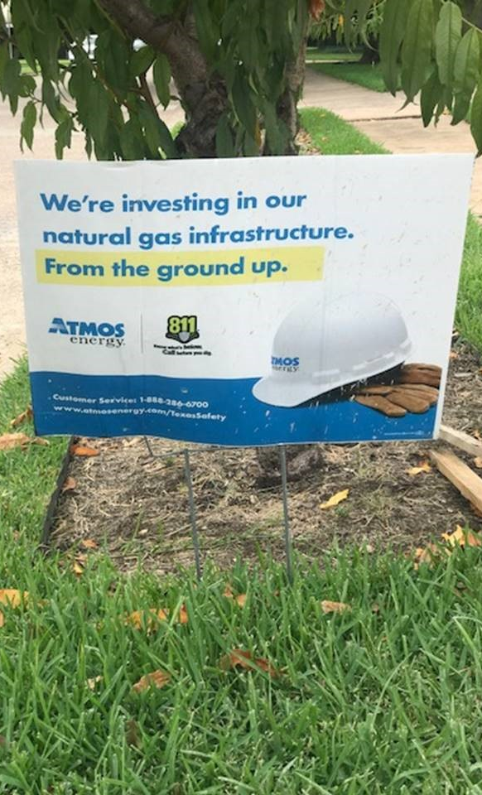
Pipe produced in Pryor, OK Line 13 June 20, 2021 8:46pm

Slide 4
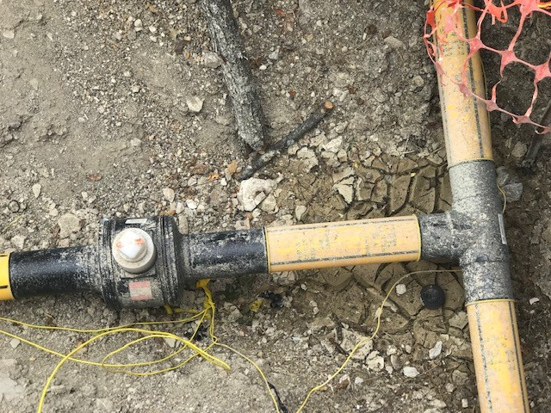
KEROTEST HDPE BALL VALVE

Slide 5
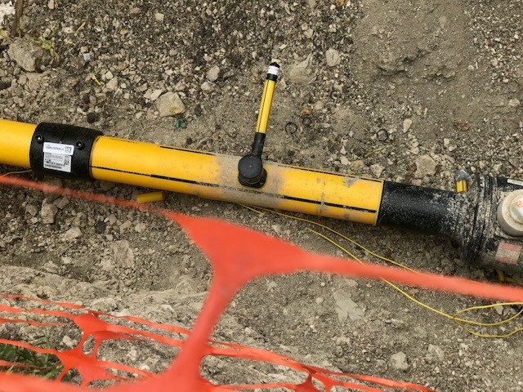
ELECTROFUSION COUPLING
TAP TEE w/ PUP
TRACER WIRE (for locating)
HDPE BALL VALVE

Slide 6
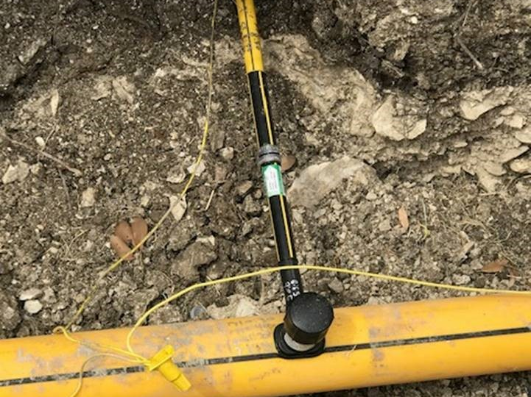
8400 Tubing
Excess Flow Valve mfg’d by a GAS OEM
Tap Tee

Slide 7
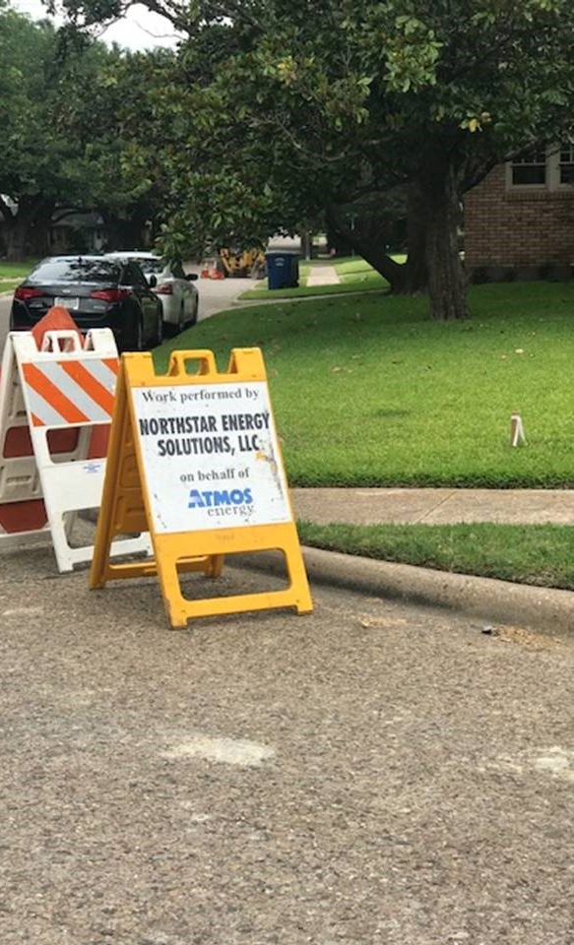
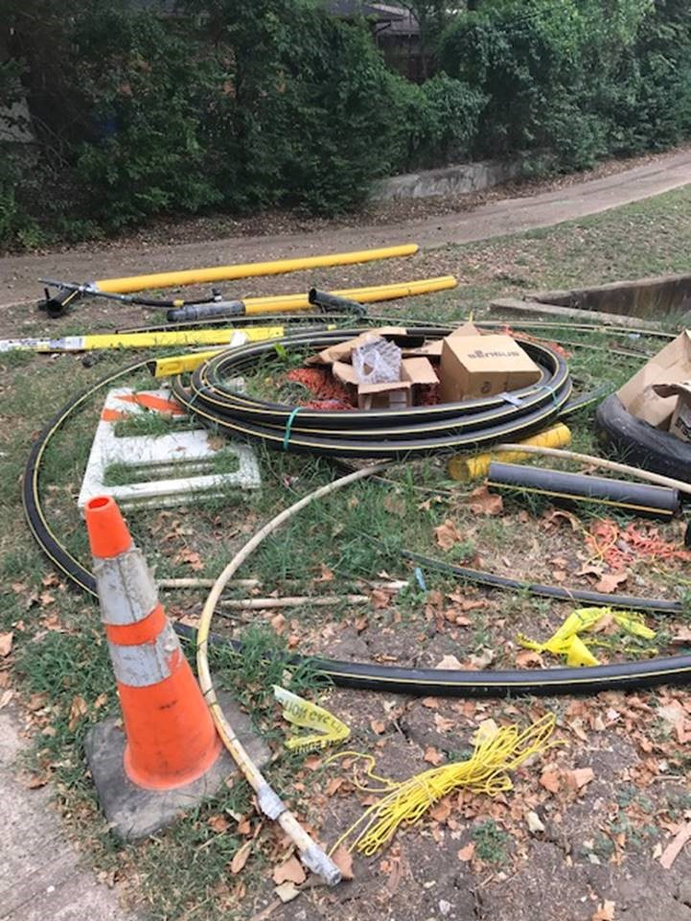
Project Pipe Boneyard ☺
Jobsite Contractor

Slide 8
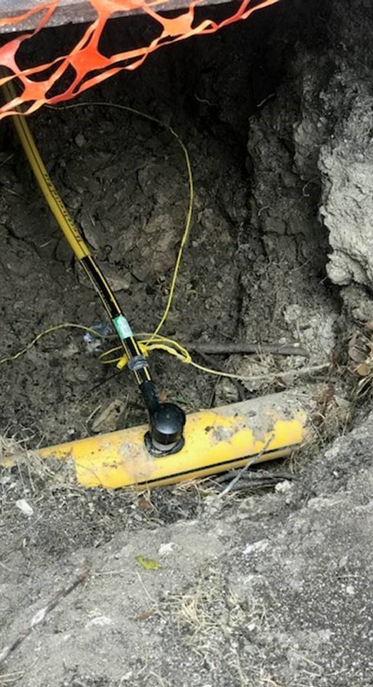
Thanks to
Teri Dean, Pricing & Customer Service Supervisor, for
“spotting” this project and to the Pryor, OK plant for making such fine looking pipe.

