Slide 1


SPRING CREEK / ALMA
PLANO, TX

Slide 2
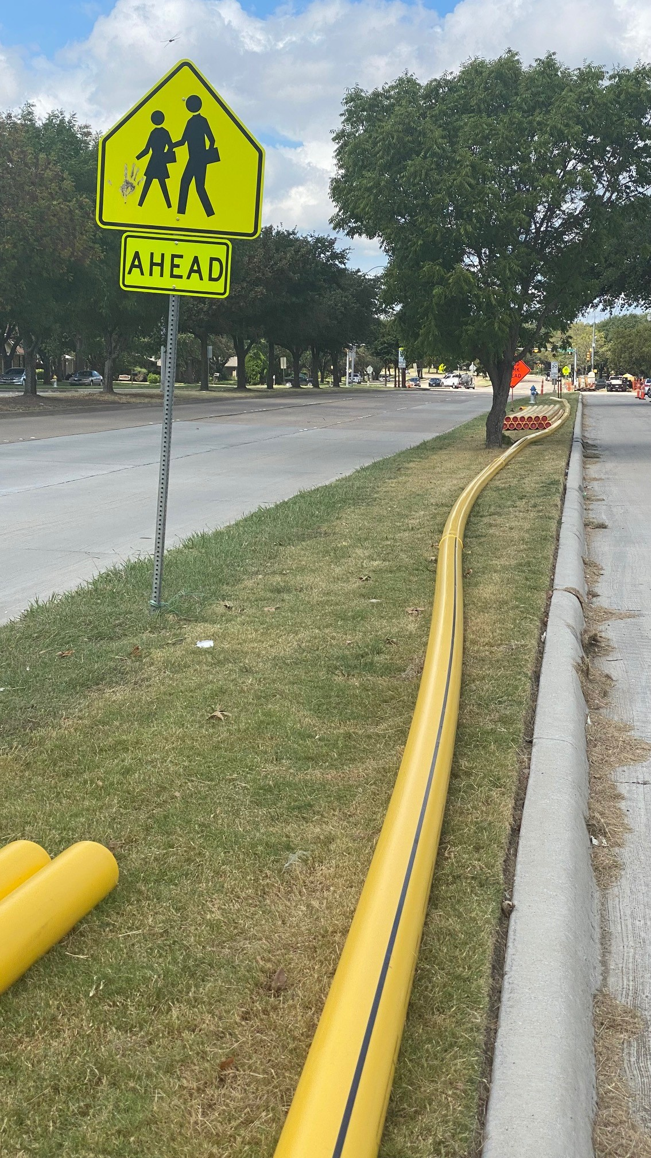
DriscoPlex®
8400 Series 6” IPS DR11 prepared for installation by Horizontal Directional
Drilling (HDD).

Slide 3
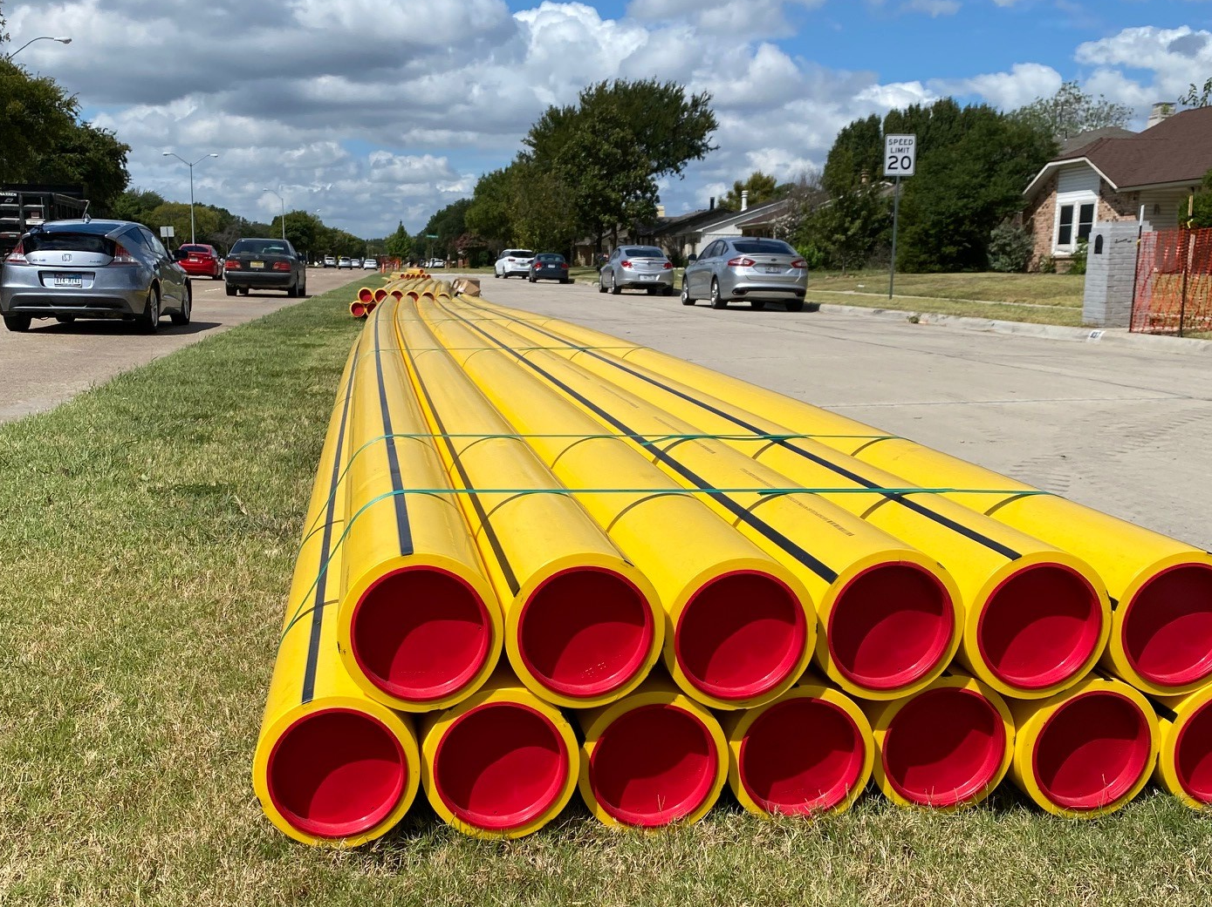

Slide 4
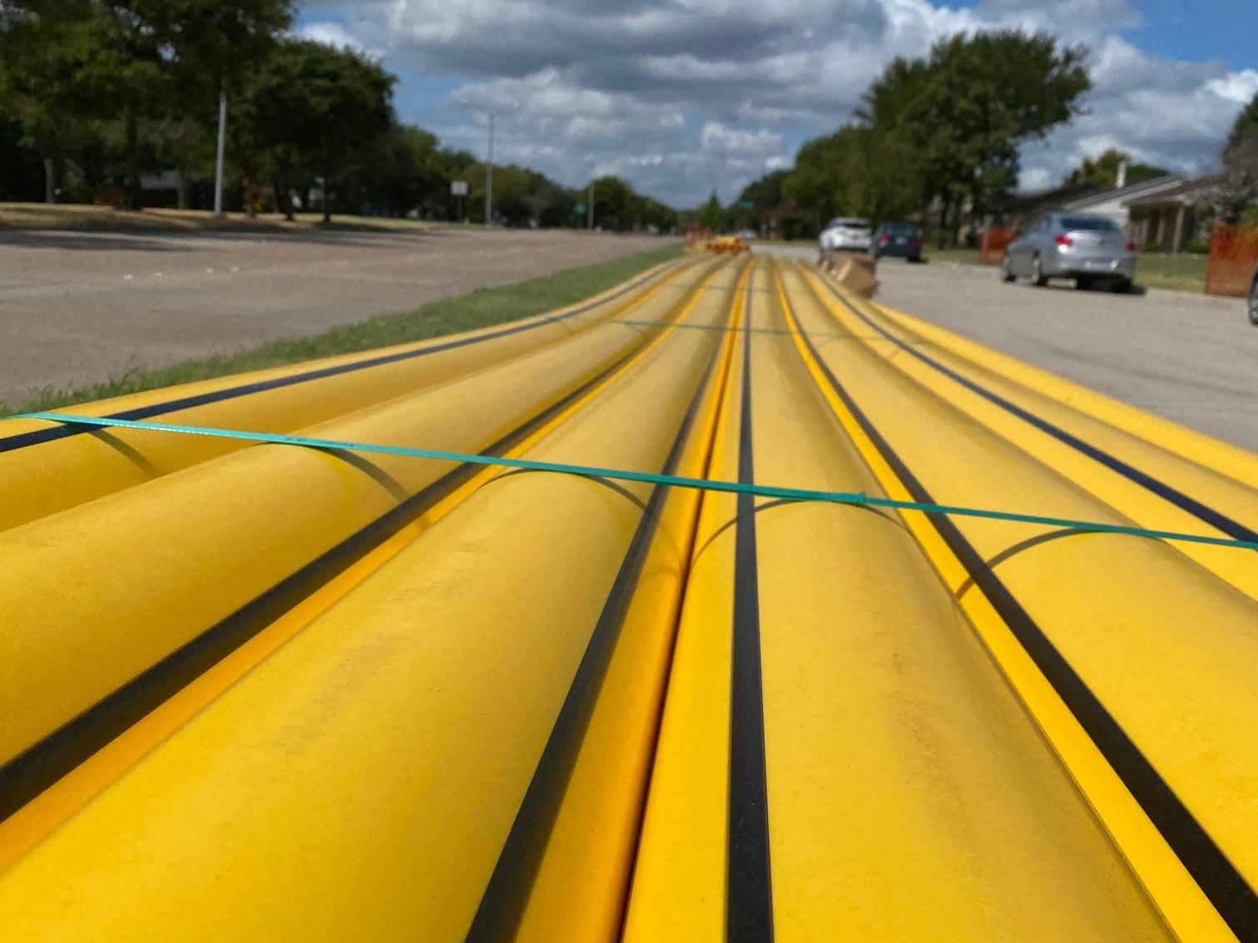

Slide 5
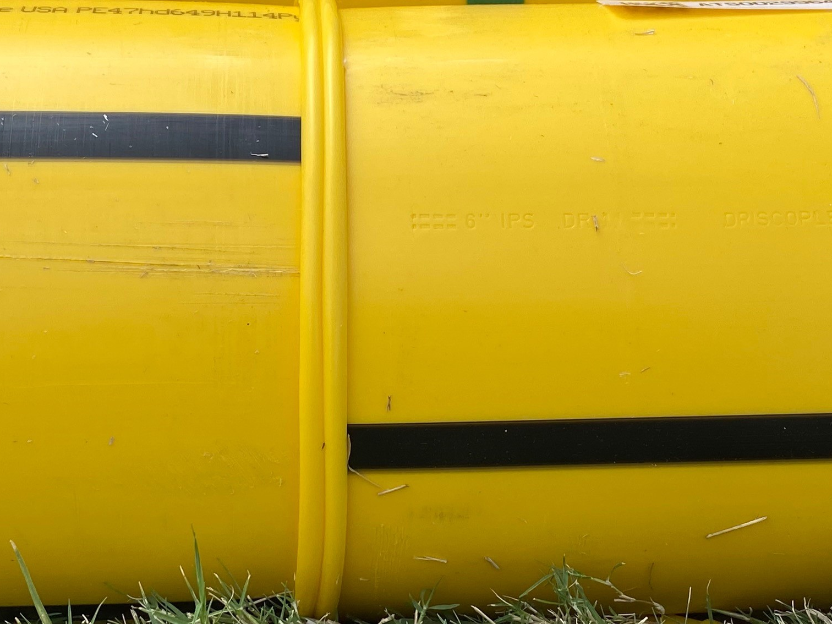

Slide 6
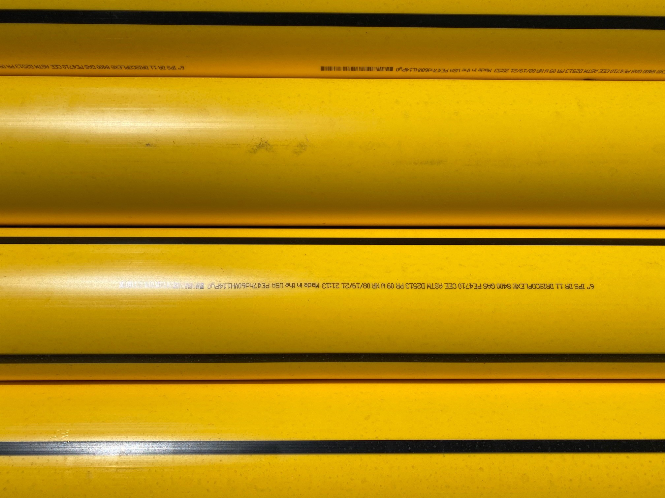
Pipe produced in Pryor, OK Line 9 August 8, 2021 9:13pm

Slide 7
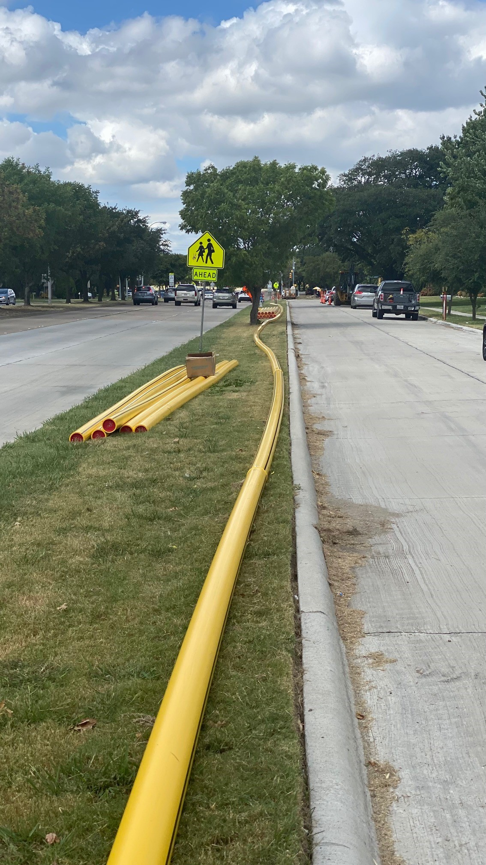
Thanks to
Joey Hummell, Scheduler, for
“spotting” this project and to the Pryor, OK plant for making such fine looking pipe.

