Slide 1


PRESTON RD. & COLEMAN ST.
PROSPER, TX

Slide 2
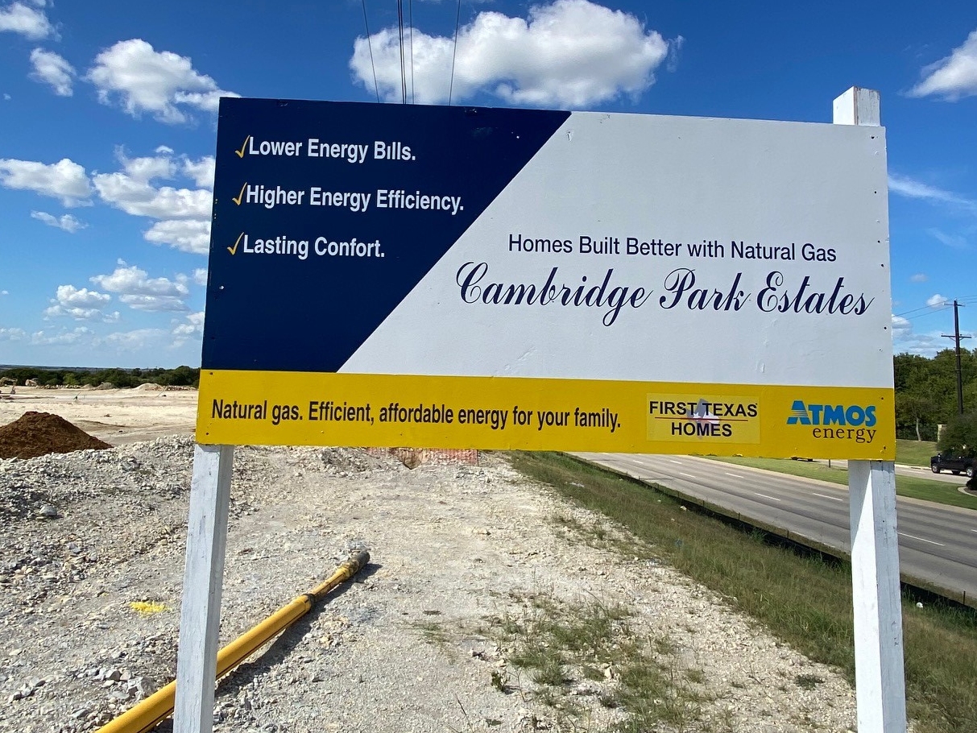

Slide 3
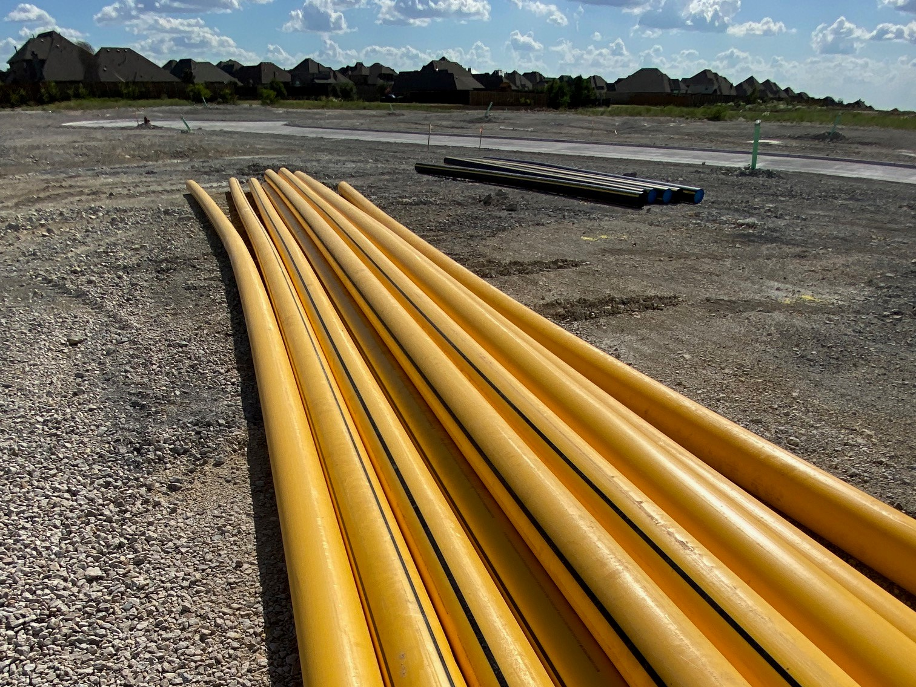

Slide 4
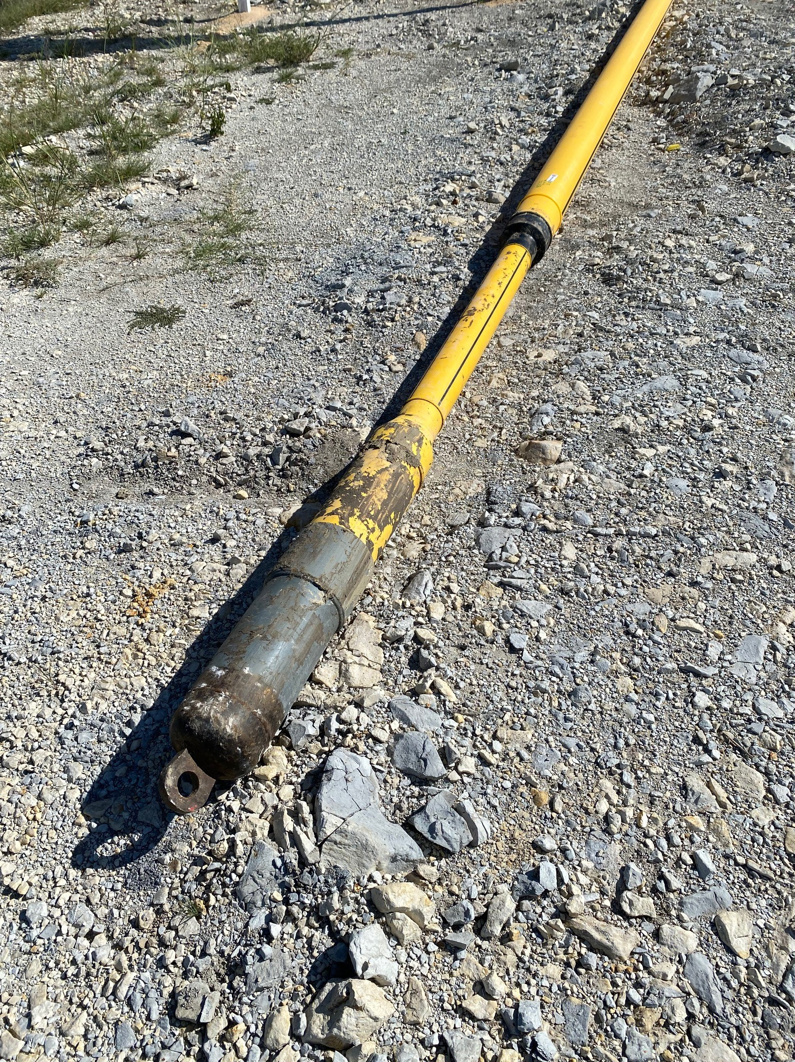
DriscoPlex®
8400 Series 6” IPS DR11 prepared for installation by Horizontal Directional
Drilling (HDD).

Slide 5
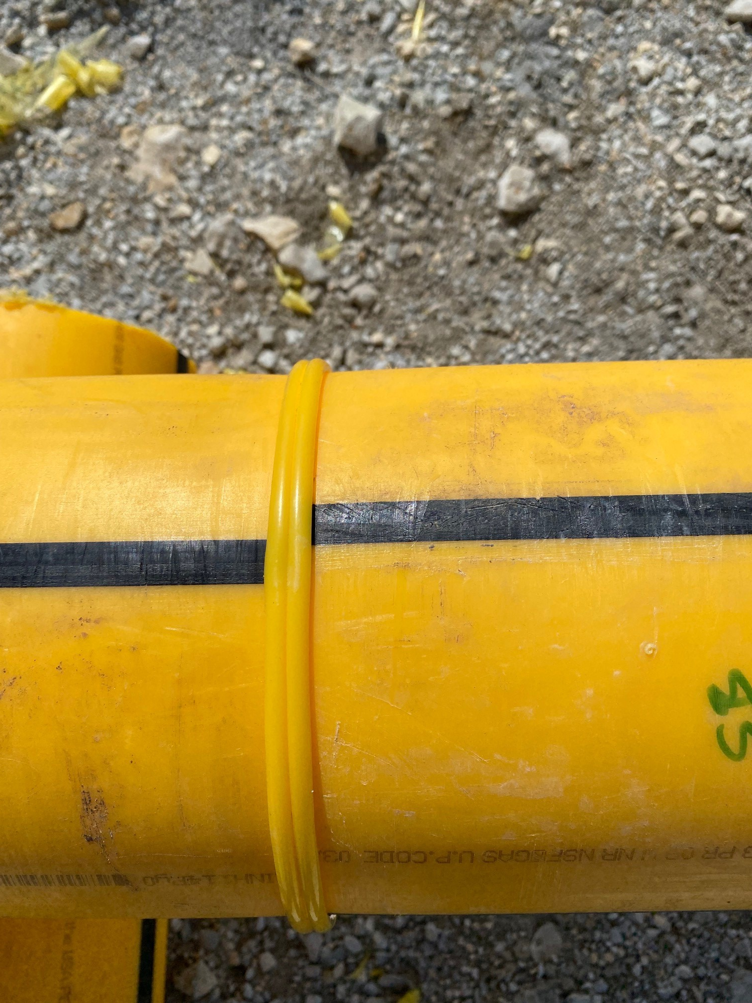
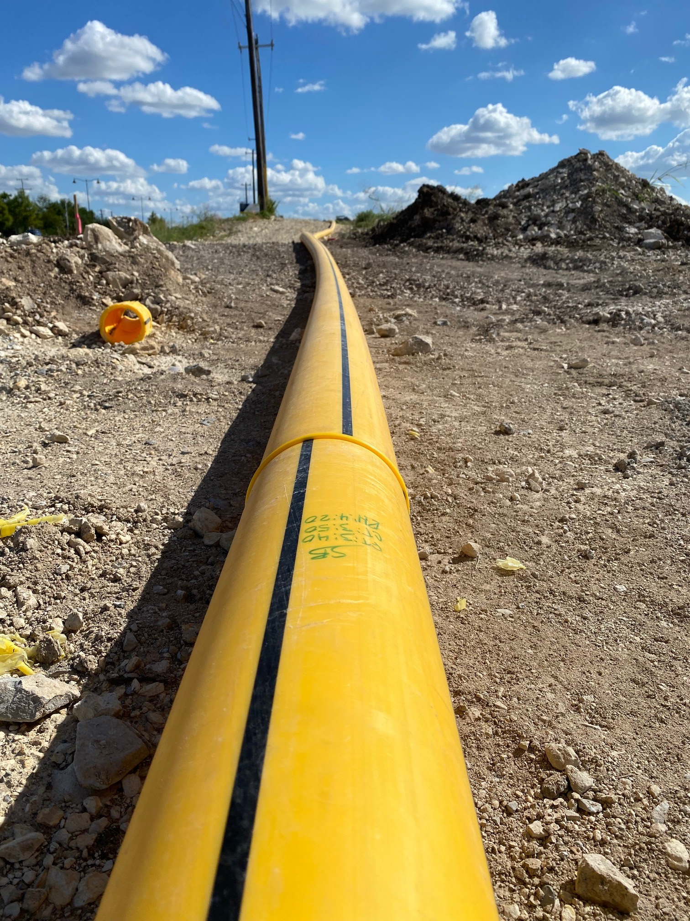

Slide 6
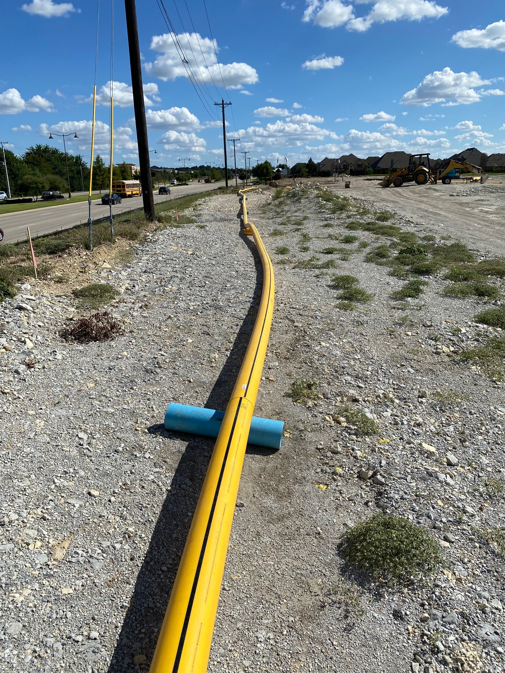
Finally…
a practical use for PVC pipe

Slide 7
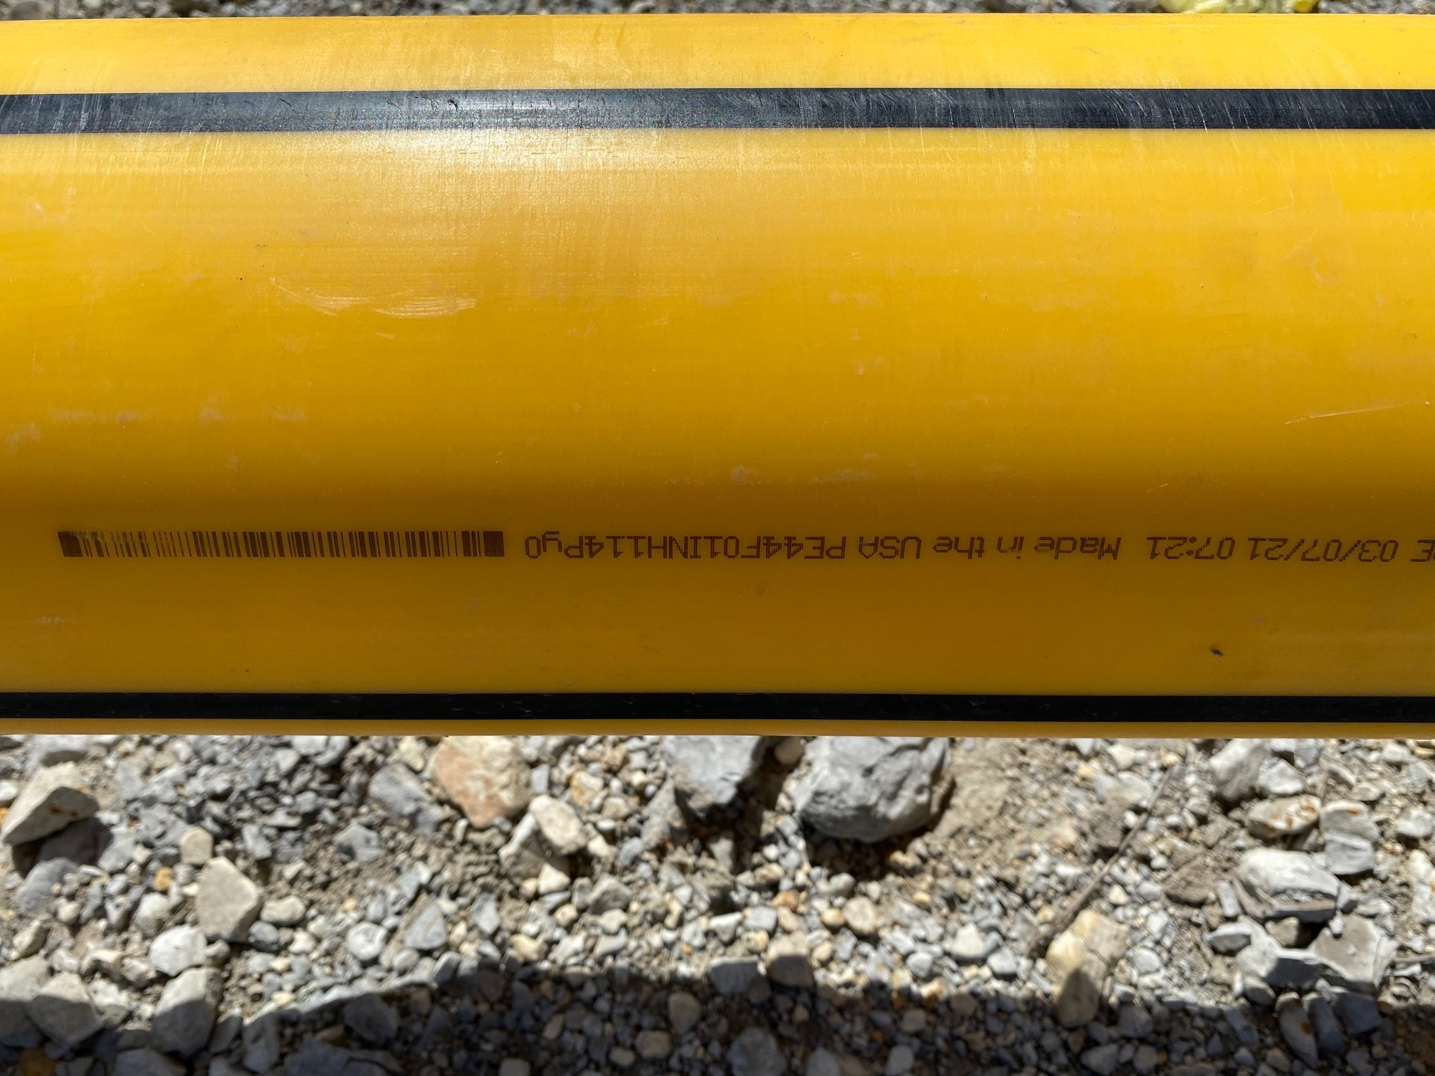
Pipe produced in Pryor, OK Line 9 March 7, 2021 7:21am

Slide 8
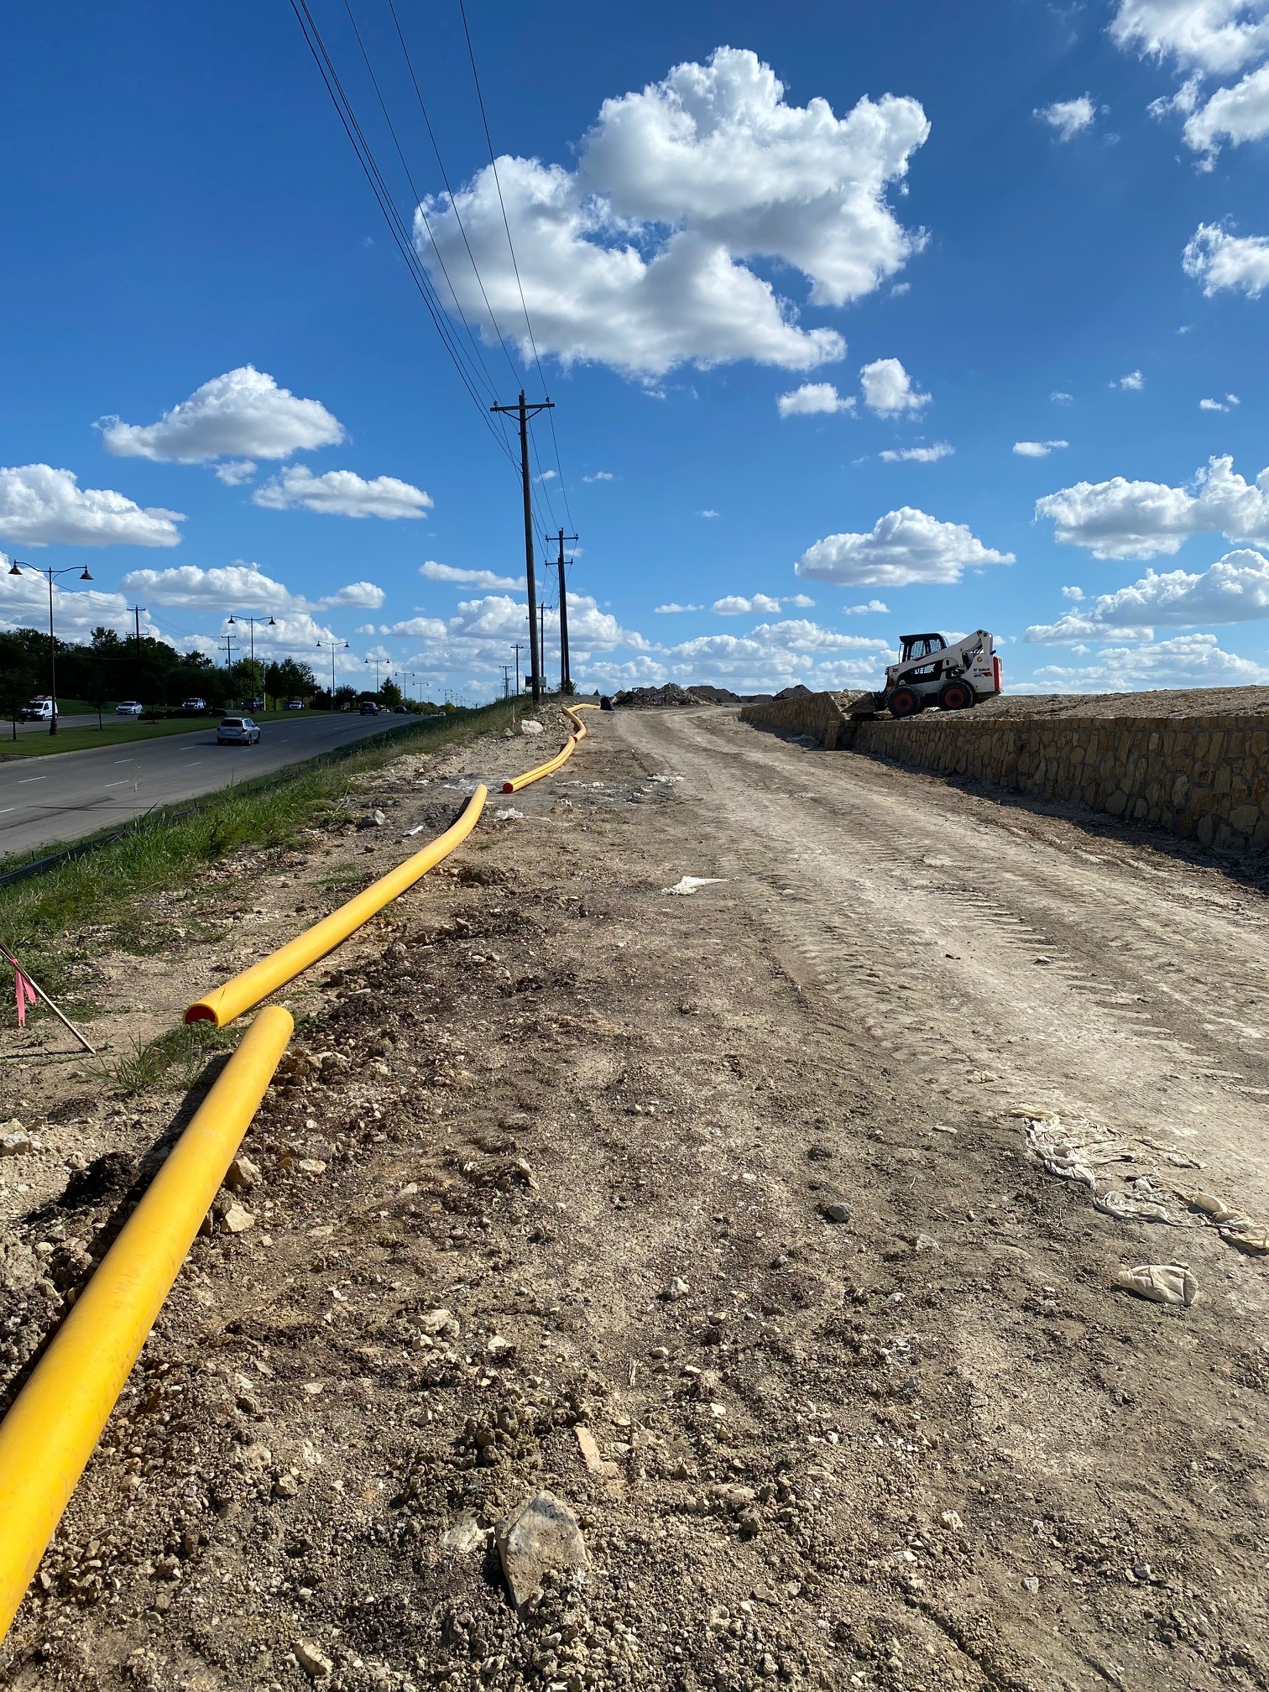
Thanks to Rose Clair, Business Services Manger for “spotting” this project and to the Pryor, OK plant for making such fine looking pipe.

